Slide 1
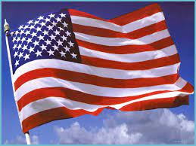
Update for National Committees Forum June 20, 2023
US National Committee for CODATA
Bonnie C. Carroll, Chair
USNC/CODATA

Slide 2
USNC in Context
Sponsored by the US National Academies of Science, Engineering and Medicine
Reconstituted June 2020, with a very long historical tradition
Part of the Board on International Scientific Organizations
With USNCs from Scientific Unions
Sister organization to the Board on Research Data and Information (BRDI)
Funded by the US National Science Foundation with 5 year grant ending in 2024
Initially meeting quarterly; 3 virtual and first in person held April 2023

Slide 3
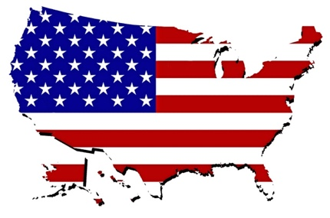
The Mission of the USNC
CODATA’s mission is to connect data and people to advance science and improve our world.
CODATA promotes global collaboration to advance Open Science and to improve the availability and usability of data for all areas of research.
The mission of the USNC is to advance the progress of science through effective data management in the US and in coordination with global efforts, consistent with the CODATA mission.
The USNC will connect the dots within the US and among the US and international goals and activities.

Slide 4
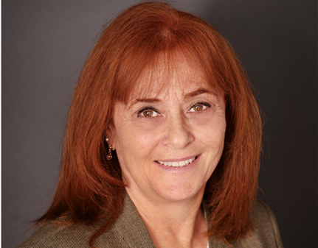
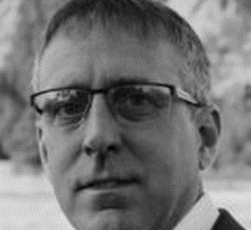
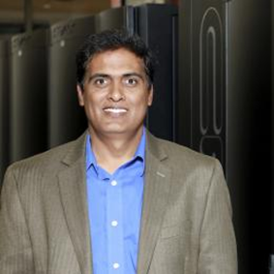
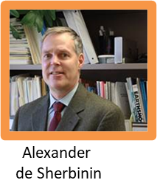
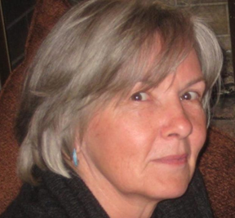
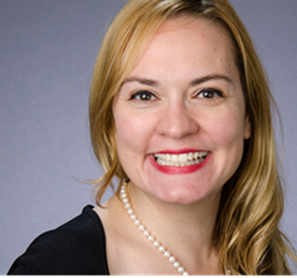
USNC/CODATA MEMBERSHIP
Chair + 12 Members
Represents All Sectors of the Economy: Academia, Industry, with Government Observes
Diversity of views (age, gender, discipline, geography, etc.)
Representatives of all Data Together organizations
Bonnie Carroll, Chair
Mark Parsons
Rebecca Koskela
Christine Kirkpatrick
Giri Prakash

Slide 5
Activities Completed
Data Science Training for Underserved Communities in the US
Overcoming Barriers to Data Science for Early Career STEM Professionals
Rural areas (Appalachia/Rural South)
Minority serving institutions
Based on RDA/CODATA School of Data Science
Funding from Microsoft
Objective is to provide a hand up to underserved regions and formation of cohort community
The program was modified to included weekly virtual for 4 weeks, in person for a week, and then 5 weeks virtual. Participants included 38 people from 16 institutions. 25 were totally active. 20 attended the in-person event.
Completed November 3, 2022
Work with BRDI on mobilizing a focus on coordination of US Open Research Commons
https://www.science.org/doi/10.1126/science.abo5947
Playing catch-up in building an open research commons
As efforts a dance around the globe, the US falls behind
PHILIPE. BOURNE , VIVIEN BONAZZI, AMY BRAND, BONNIE CARROLL, IAN FOSTER, RAMANATHAN V. GUHA, ROBERT HANISCH, SALLIE ANN KELLER, MARY LEE KENNEDY, [...],

Slide 6
Ongoing Activities for 2023
US National Data Summit
Convene about 30-40 data organizations based in the US to discuss a “Data Together”– like cooperation
3 Phases
Survey of US Organizations to gather input on areas for cooperation completed
Hold Focus Groups to further discussion priority topics in process
4 Cross cutting topics: Indigenous, JEDI, AI, Policy)
2 application areas (Data Needs for Decarbonization, Data for Disruption: Responding to Disasters and Shocks in Disadvantaged Communities)
Convene US Research Data Summit in October 10-11, 2023

Slide 7
New Activities for 2023-24
Focus on the Next Generation Data Professional
Data Science, Science of Data, Data Management need to develop common understanding
Parallel Universes: Challenge for CODATA and the community
There are at least two universes associated with data science and they seem to operate in parallel. This makes no sense to me. We are not talking about antimatter and matter, where contact would lead to annihilation. We are talking about two universes with a commonly shared matter (aka data) and energy (aka scientists). Let me explain.
Submitted session for SciDataCon 2023 in cooperation with Academic Data Science Alliance
Interest in connecting young professional communities

Slide 8
Challenges
Funding
Dues
Support
Programs
Succession planning
Staff support
Coordination with other data organizations

Slide 9
Thank you!

